Slide 1

Chapter 29 – part I

Slide 2
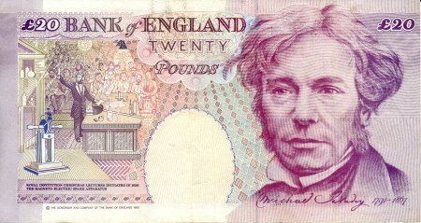
OUTLINE
  Magnetic flux and induced current.
  Faraday’s law.
  Lenz’s law.

Slide 3
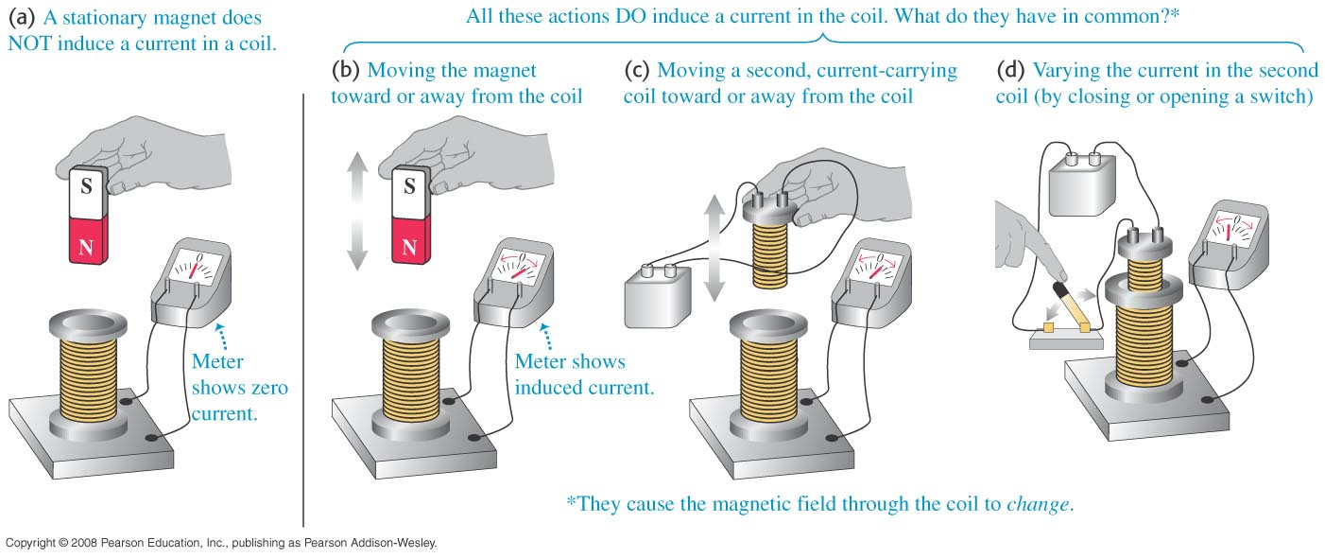
Induced current
  A changing magnetic flux causes an induced current.
  The induced emf is the corresponding emf causing the current.

Slide 4
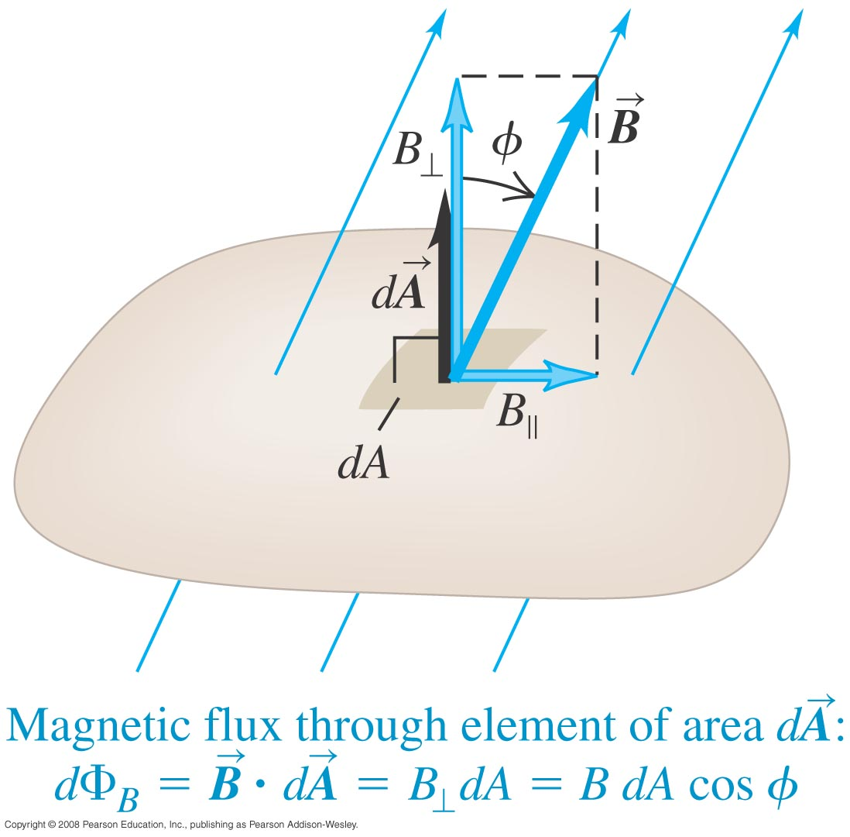
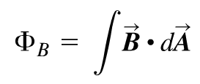
Magnetic flux through an area element
  Figure below shows how to calculate the magnetic flux through an element of area.

Slide 5
Problem #1

Slide 6
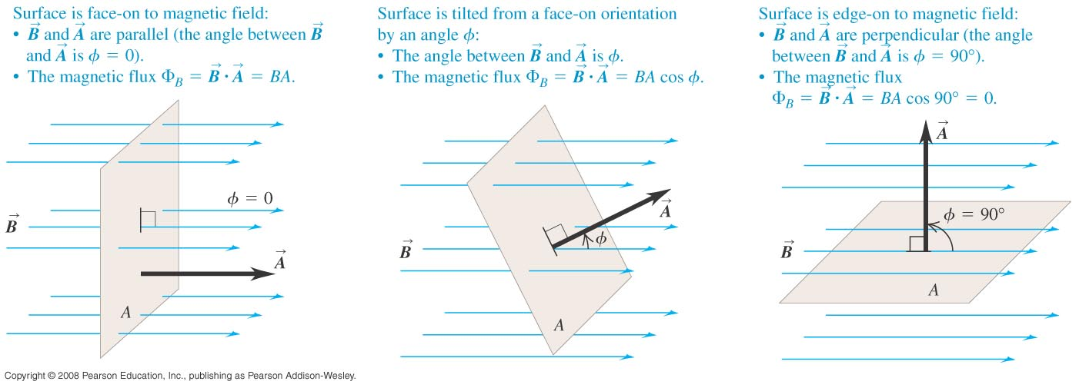
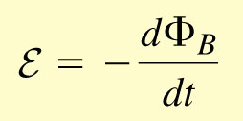
Faraday’s law
  The flux depends on the orientation of the surface with respect to the magnetic field.
  Faraday’s law: The induced emf in a closed loop equals the negative of the time rate of change of magnetic flux through the loop.

Slide 7
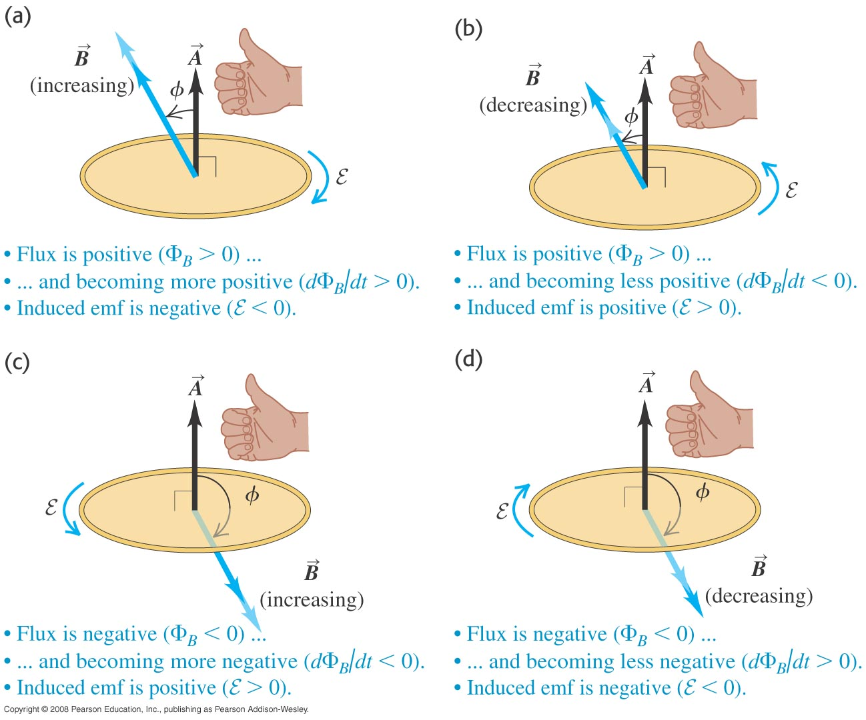
Direction of the induced emf
  Lenz’s law: The direction of any magnetic induction effect is such as to oppose the cause of the effect.

Slide 8
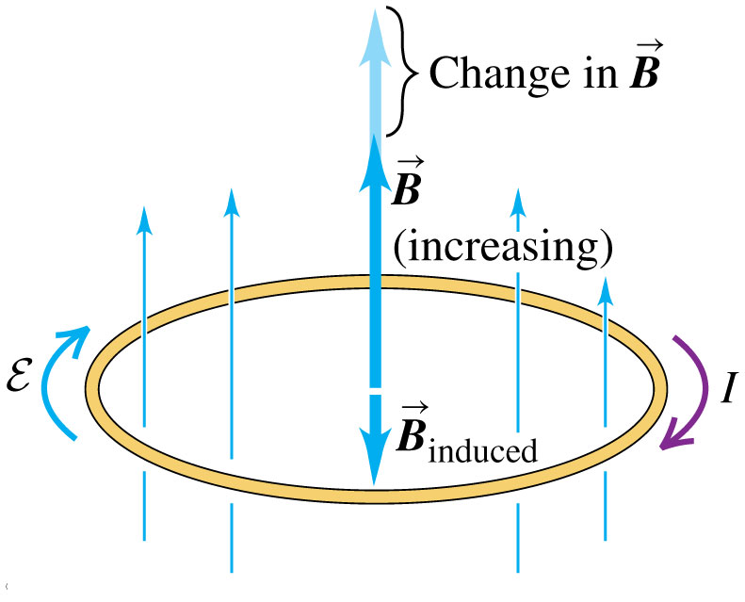
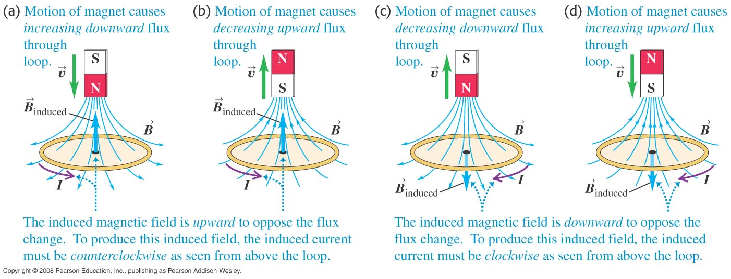
Lenz’s law and the direction of induced current

Slide 9
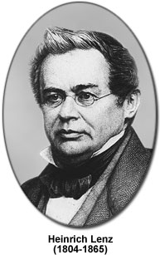
Lenz’s law and the direction of induced current
The direction of the induce emf is such that the magnetic flux associated with the
current generated by it, opposes the original change of flux causing emf.

Slide 10
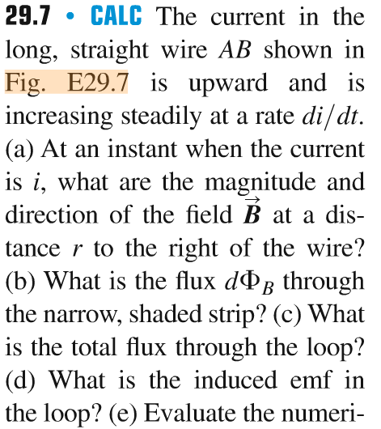
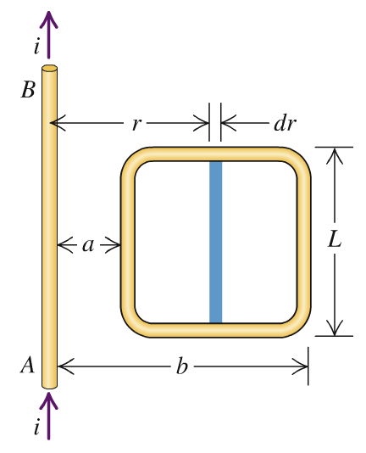
Problem #2

Slide 11
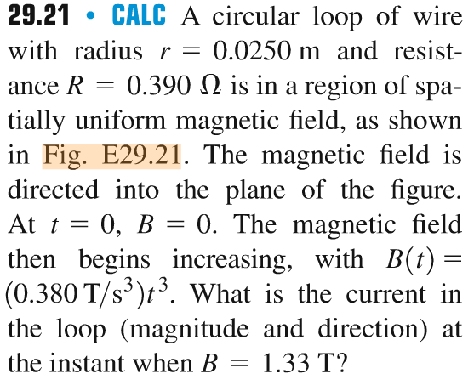
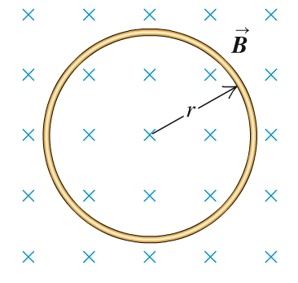
Problem #3

Slide 12
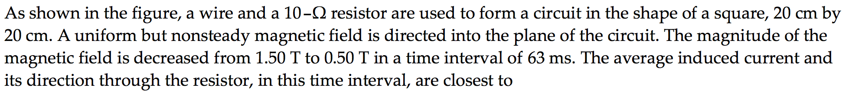
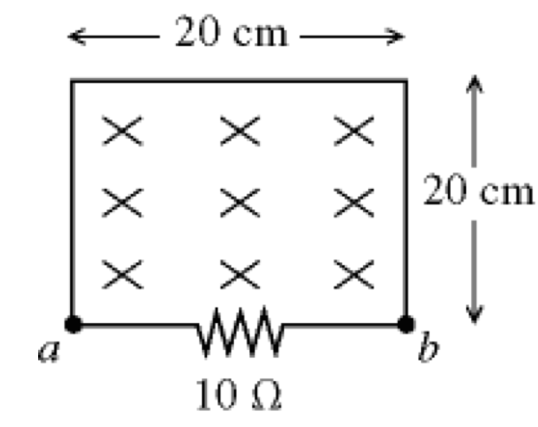
Problem #4
…

Slide 13
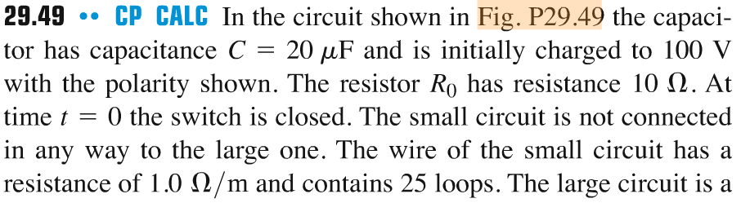
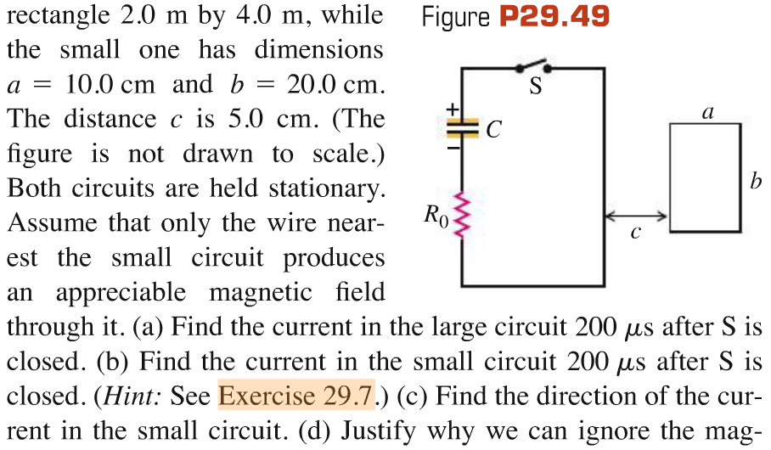
Problem #5

